Slide 1
INDUSTRIAL COPPER MODELING
Presented by
Janani J

Slide 2
Problem Statement:
The copper industry deals with less complex data related to sales and pricing. However, this data may suffer from issues such as skewness and noisy data, which can affect the accuracy of manual predictions. Dealing with these challenges manually can be time-consuming and may not result in optimal pricing decisions..

Slide 3
A machine learning regression model can address these issues by utilizing advanced techniques such as
data normalization
feature scaling
outlier detection,
leveraging algorithms that are robust to skewed and noisy data.
Another area where the copper industry faces challenges is in capturing the leads. A lead classification model is a system for evaluating and classifying leads based on how likely they are to become a customer . You can use the STATUS variable with WON being considered as Success and LOST being considered as Failure

Slide 4
Problem Enhancement
This problem statement involves two main tasks: creating a regression model to predict the selling price and a classification model to predict the status of leads. Below are the steps to achieve the solution, along with a Streamlit application to facilitate user interaction with the models.

Slide 5
These are the steps followed:
1.Exploring Skewness and Outliers in the Dataset
Load the Dataset
Exploratory Data Analysis (EDA)
2.Data Transformation and Pre-processing
Data Cleaning
Data Transformation
Outlier Treatment
3.Regression Model for Predicting Selling Price
Feature Selection
Model Selection
Model Training, Evalution
4.Classification Model for Predicting Lead Status
Data Preparation
Feature Selection
Model Selection , Training and Evalution.
5.Streamlit Application

Slide 6
Improved Accuracy
Efficiency
Scalability
Robustness
Data-Driven Insights
Benefits of Machine Learning in the Copper Industry

Slide 7
Objective: Predict the continuous variable 'Selling_Price'.
Algorithms: Decision Trees, Random Forests, and Gradient Boosting Machines (GBMs) , Ada Boosting,Extra Tress.
Model Evaluation: Metrics such as Mean Absolute Error (MAE), Mean Squared Error (MSE), and R-squared are used to assess model performance.
Machine Learning Regression Model

Slide 8
Machine Learning Classification Model
Objective: Predict the lead status (WON or LOST) based on the 'STATUS' variable.
Algorithms: Decision Trees, Random Forests, and Gradient Boosting Classifiers. Extra Tree and Ada boost Classifier
Model Evaluation: Accuracy, Precision, Recall, F1-Score, and ROC-AUC are typical metrics for classification performance.

Slide 9
Streamlit Application
User Interaction: A Streamlit application allows users to input feature values and get predictions for 'Selling_Price' or 'Status’.
Model Integration: Incorporating the trained models into the app for real-time predictions.
Visualization: Displaying results and model insights to help users understand predictions.

Slide 10
Model Comparison Analysis
Random Forest is chosen over other models due to its balance between high accuracy, robustness, and generalization ability. Despite the Decision Tree and Extra Trees having high R² scores, the Random Forest's ability to handle overfitting, provide feature importance, and maintain consistency across different data subsets makes it a strong candidate for practical use.

Slide 11
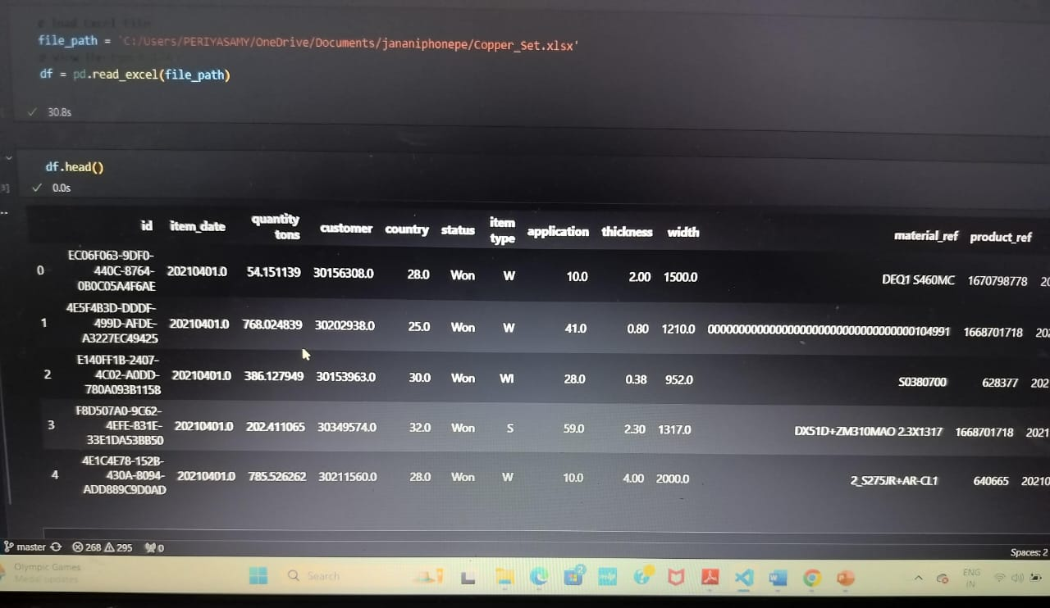
Data Set: Copper Modeling

Slide 12
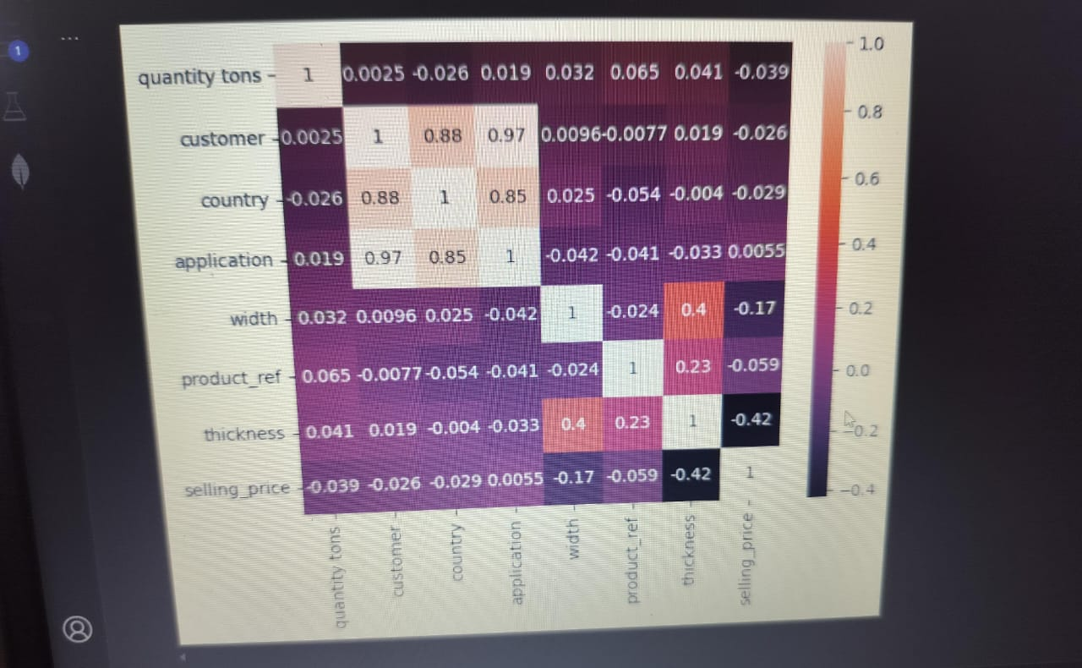
DataVisulization- Correlation Using HeatMap

Slide 13
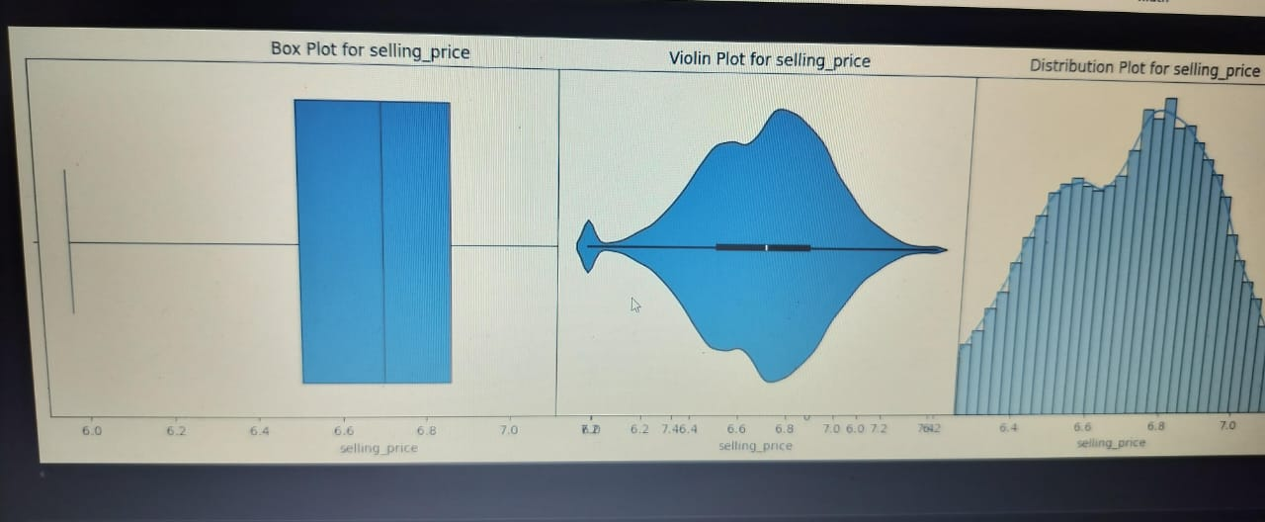
Box Plot- violin Plot- Distribution Plot: Selling_price

Slide 14
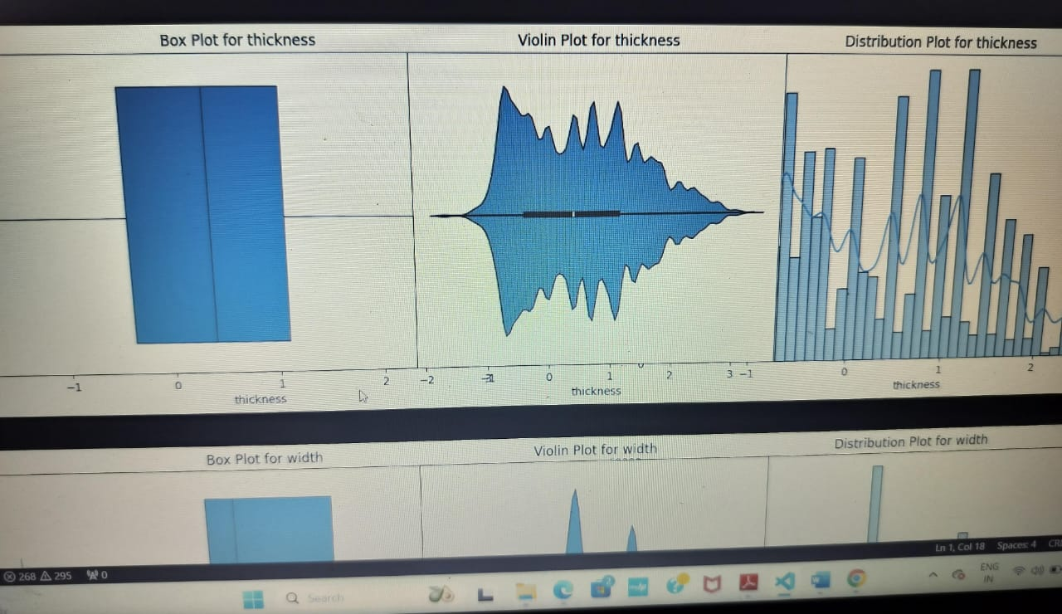
Box Plot- violin Plot- Distribution Plot: Thickness

Slide 15
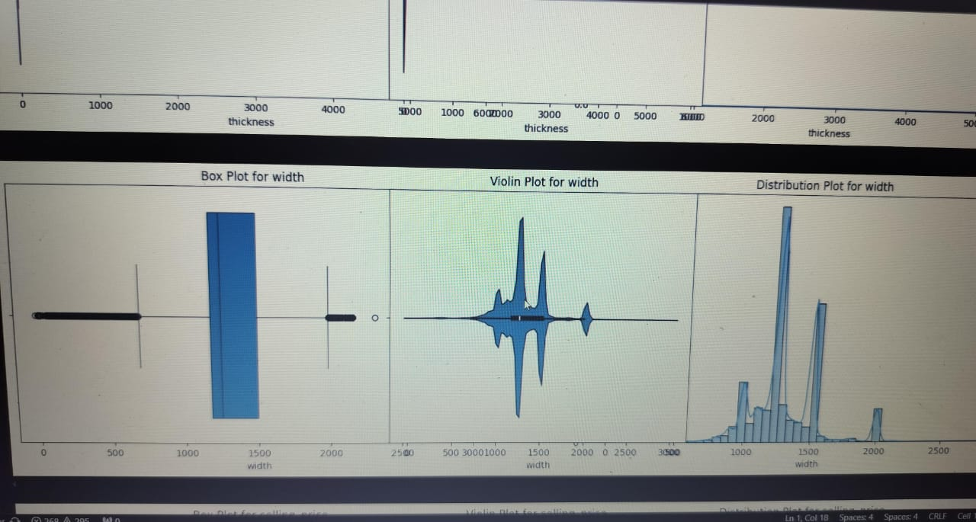
Box Plot- violin Plot- Distribution Plot: Width

Slide 16
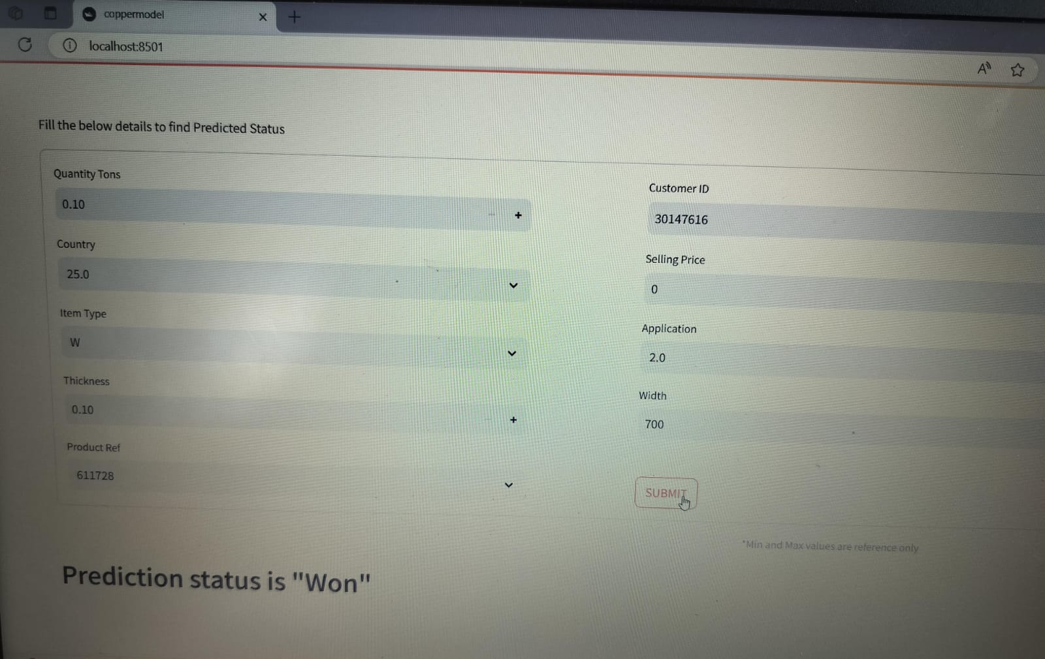
Final Outcomes-Status Prediction

Slide 17
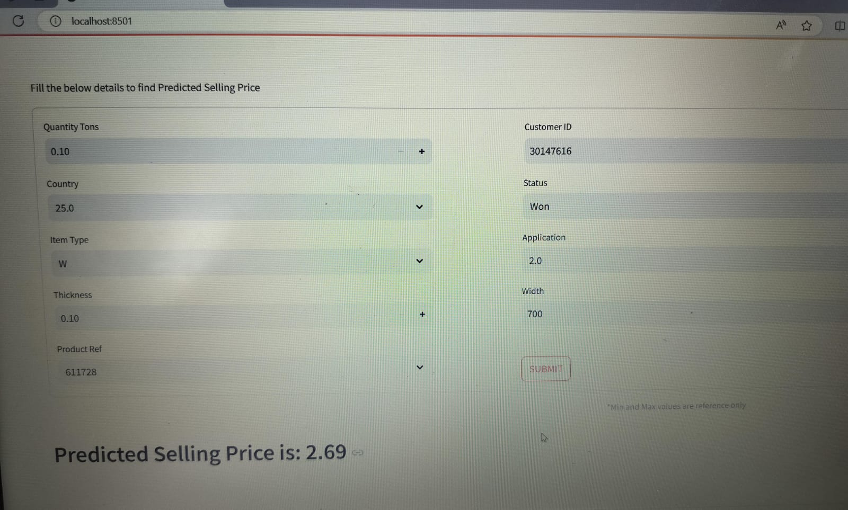
Selling Price prediction

Slide 18
Conclusion
Applying machine learning to the industrial copper sector offers significant advantages in handling complex data challenges and improving prediction accuracy. By following a systematic approach to preprocessing model training, and application development, businesses can leverage ML to enhance their pricing strategies and lead management processes, ultimately driving better business outcomes.

